Slide 1
Preparing for What Comes Next!
Monica Ahearn
INCLUDENJ

Slide 2
Follow the Code…
6A:14 3.7 (11) Indicates that starting at age 14 or younger if determined appropriate by the IEP Team the following information should be included and updated annually;
Statement of the student’s strengths and weaknesses
Identification of a course of study and related activities that are consistent with the student’s strengths and intended to assist the student in attaining postsecondary goals.

Slide 3
Transition Starts at 14
3. As appropriate a description of the need for consultation from other agencies .
4. As appropriate a statement of any needed interagency linkages and responsibilities.

Slide 4
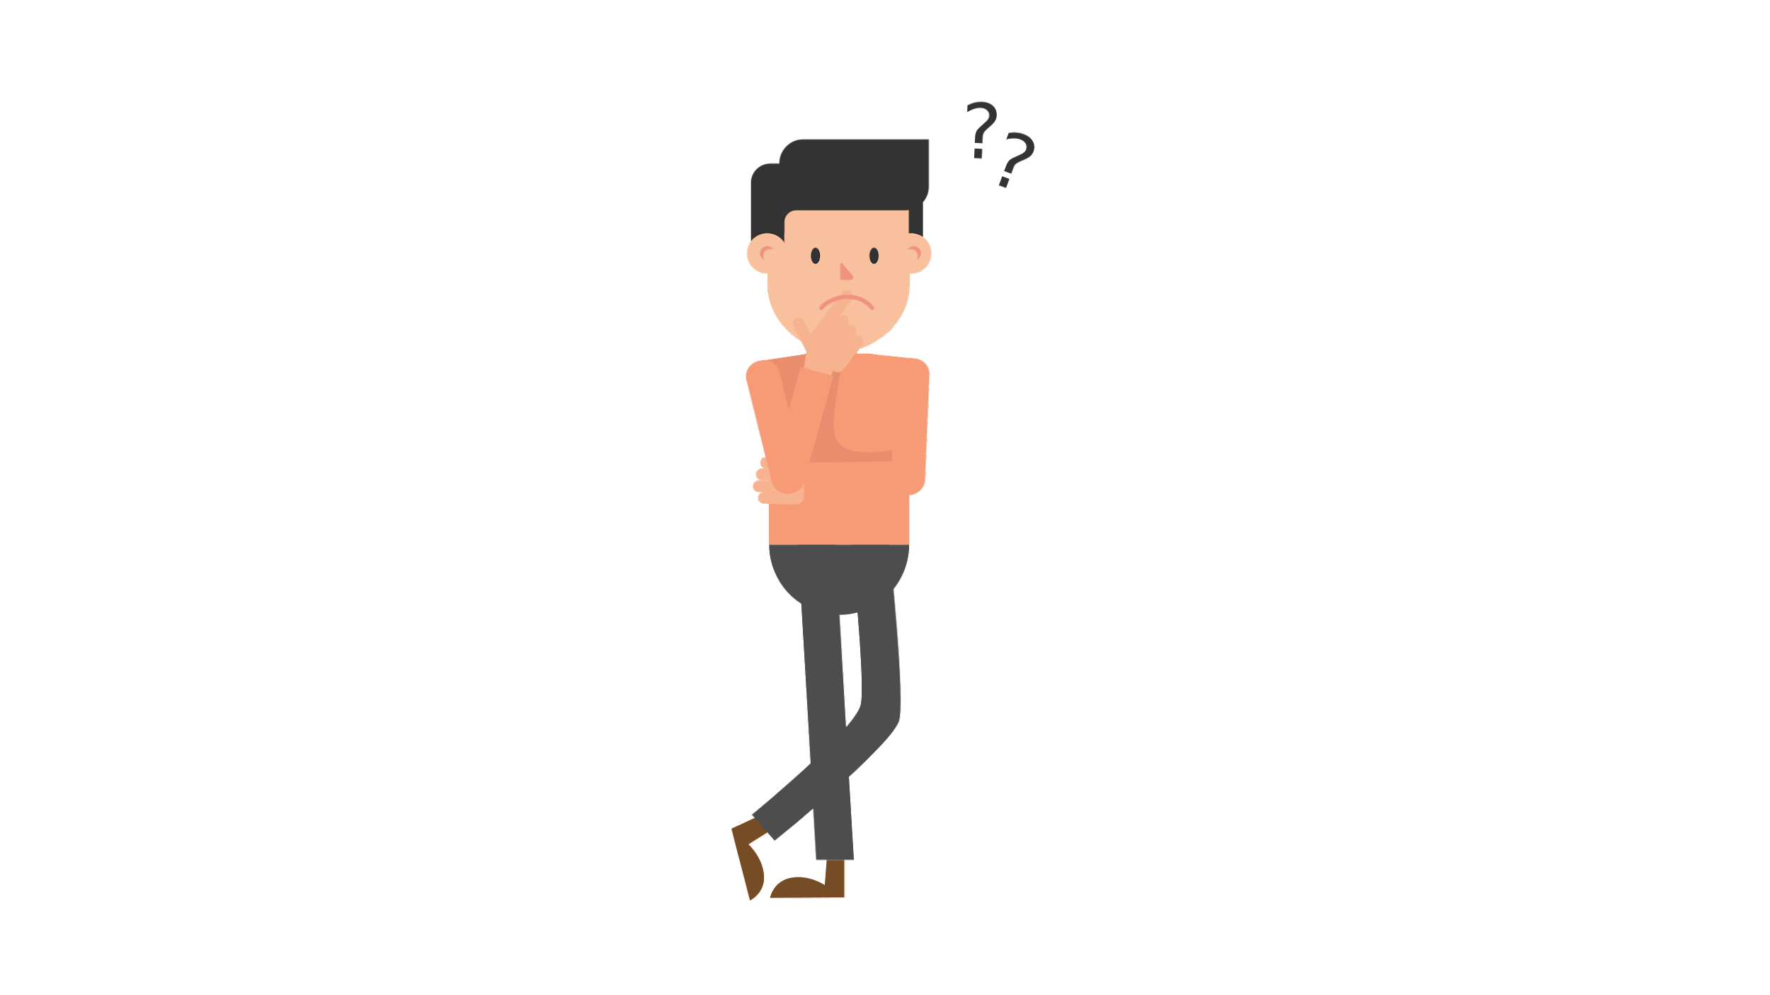
WHAT DOES YOUR CHILD’S IEP SAY?
Does the transition section reflect their interests?
How will they reach their post secondary goals?

Slide 5
What is a Transition Plan?
You, your child, and the rest of the IEP team will develop a transition plan connected to the IEP. It will include your child’s goals for after high school, and the services and programs that will help prepare them to meet those goals.

Slide 6
Components of a Transition Plan
*Further education and training
*Employment
*Independent or supported living
*Community engagement

Slide 7
Career Pathways - All Options are not Equal
As students and youth with disabilities prepare for their careers, they should be counseled to consider and explore a specific career to determine if it meets their career interests, abilities and goals.
The Career Pathways model is designed to facilitate an individual’s career interest and advancement with multiple entrance and exit points in the individual’s career over his or her lifetime.
Key program design features of the Career Pathways model include contextualized curricula, integrated basic education and occupational training, career counseling, support services, assessments and credit transfer agreements that ease entry and exit points towards credential attainment.

Slide 8
Community Based Work Experiences
Whether the student’s next step is employment or entering a postsecondary training or an educational program, it is important for students with disabilities to obtain as much work experience as possible to prepare for adult life. The National Collaborative on Workforce and Disability for Youth (NCWD) reports that the value of a work experience, whether paid or unpaid work: • Helps students acquire jobs at higher wages after they graduate; and • Promotes students who participate in occupational education and special education in integrated settings to be competitively employed more than students who have not participated in such activities.

Slide 9
Internships
Internships are formal agreements whereby a student or youth is assigned specific tasks in a workplace over a predetermined period of time. Internships can be paid or unpaid, depending on the nature of the agreement with the company and the nature of the tasks.4 Internships are usually temporary on-the-job work experiences. They not only provide individuals, including students and youth with disabilities, actual work experience and the opportunity to develop skills, but also the opportunity to determine if the type of work involved is in keeping with the individuals’ career interests, abilities and goals. There is no guarantee that an internship will lead to a permanent employment offer. However, VR counselors refer students or youth with a disability to an internship to increase their employment opportunities. The internship experience is frequently enriched by the provision of services or supports, such as transportation and vocational counseling,

Slide 10
Mentorships
A young person with or without a disability may participate in a mentoring relationship to hone his or her occupational skills and work habits. The business community describes mentoring as an employee training system under which a senior or more experienced individual (the mentor) is assigned as an advisor, counselor, or guide to a junior or trainee (mentee). The mentor is responsible for providing support to, and feedback on, the individual in his or her charge. The mentor’s area of experience is sought based on his or her career, disability, and history or life experience similar to the mentee or a host of other possibilities.

Slide 11
Paid Employment
Paid Employment involves existing standard jobs in a company or customized employment positions that are negotiated with an employer. These jobs always feature a wage paid directly to the student or youth. Such work is scheduled during or after the school day. Paid employment is frequently an integral part of a student’s course of study or simply a separate adjunctive experience. Often times, these employment experiences are the first steps towards building a meaningful career for students and youth with disabilities

Slide 12

Preparing for Graduation
Graduation Plan
Additional responsibilities
Pay Attention to Mental Health
Realistic Expectations

Slide 13
Individual Graduation Plan
AS a student with an IEP your child has a right to an education until they are 21. You should decide together with the CST when is the appropriate time for your child to graduate.
Individual Graduation Plan (IGP) describes your student’s path through high school to make sure they are ready to graduate. This will include what courses they will take and how teachers will assess their performance.As

Slide 14
Summary of Performance and Other Documents
Summary of Performance A summary of performance (SOP) is required for each student with an IEP whose eligibility for services under IDEA terminates due to graduation from secondary school with a regular high school diploma or due to exceeding the age of eligibility for FAPE under State law. The school district must provide the student with a summary of the student's academic achievement and functional performance that includes recommendations on how to assist the student in meeting the student's postsecondary goals. This summary of the student’s achievement and performance can be used to assist the student in accessing postsecondary education and/or employment services.

Slide 15
Evaluations
Ask the District to evaluate your child in his senior year regardless of when they are “due” for the reevaluation process. It is important that they have updated assessments to use for their post secondary programs. This includes colleges, technical schools and DVRS.

Slide 16
College Bound
If college is in your child’s future here are some tips to keep in mind.
Evaluations need to be up to date
Register your child as a student with disabilities
No IEP - 504 Plan
Your child will need to be able to advocate for themselves
The college will not speak with you
Consider College Programs for Students with Disabilities

Slide 17
Programs for Students with Disabilities
18-21 year old Programs vs Traditional Programs
If the Team has decided that your child is not ready to graduate yet ( even though they have met their academic requirements). It may be possible for them to attend one or more years in a 18-21 year old program. These programs can take place in many different locations including colleges, your local high school and out of distinct locations. Depending on the Individual needs of your child.
Your child can participate in graduation without accepting their Diploma

Slide 18
College Programs for Students with Disabilities
https://www.petersons.com/blog/20-great-colleges-for-students-with-learning-disabilities/
https://www.verywellhealth.com/best-colleges-and-universities-for-disabled-students-
https://www.bestvalueschools.org/colleges-for-students-with-autism/

Slide 19
Added Responsibilities
Starting asking your teen to take on additional responsibilities around the house.
Have them start making more decisions
It is important that they learn to make decisions for themselves.

Slide 20

Pay Attention to Mental Health
Do you notice your teen acting differently
Are grades dropping
New Friends
No Friend
Withdrawn
It is important to keep talking to your teen make sure that the pressure of having to decide what’s next or keep up is not too much

Slide 21
Realistic Expectations
Talk Honestly about your expectations for your teen.
What do they want to do?
College is not the only answer.
Community College is a good alternative

Slide 22
DVRS
The New Jersey Division of Vocational Rehabilitation Services (DVRS) works with students who have disabilities, including those with a 504 Plan or other documented disability that impedes a student’s ability to succeed in competitive employment.
Referral
A student, may be referred to DVRS at age 14. The person who refers them may be a staff person from their school like a teacher or someone the child study team, but a parent or another adult can refer to DVRS as well. Usually this referral is made in senior year of high school

Slide 23
DVRS
If your child is found eligible for services from DVRS they will work with the counselor to create an
IPE individualized Plan for Employment IPE
An IPE includes vocational goals (the type of work you will be doing) and the services you will receive in order to meet those goals.

Slide 24

Questions, Comments, Discussion…
Monica@includenj.org

